Slide 1
Sales Report

Slide 2
What is the General Profit ?
What is the most Category that are sold?
What is the highest country are selling?
What is the highest occurrence in profit?

Slide 3
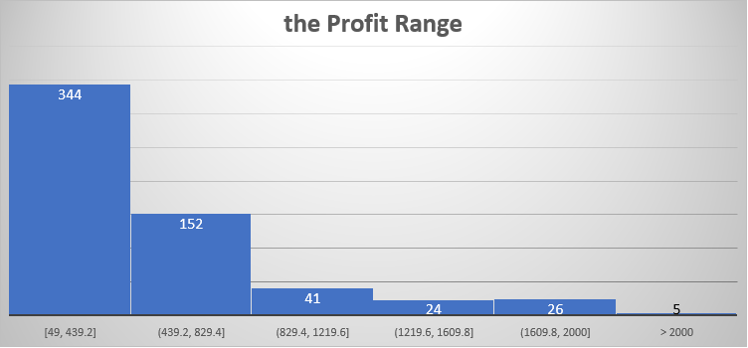
Report Profit from 2011 till 2016.
- The General trends are upwards except United Kingdome have in upside down.
United states have the highest Sales then Most Countries.
What is the profit range that has the highest occurrences?
- Between 49 to excluding 439.2, we have 344 occurrences .
- We can say most people spent their money between 49 dollars to 439.2 dollars.

Slide 4
- Most orders Quantity are Coming from United States hens why we have highest profits.
Most of the customers buy Accessories .
Even though the order Quantities of the Accessories are much higher than Bikes, but we see that most of our profit comes from the Bikes.

Slide 5
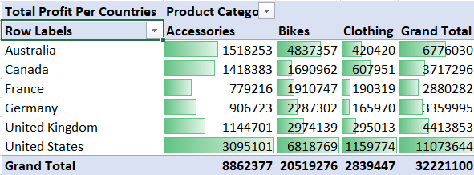
Total Profit Per Countries.

Slide 6
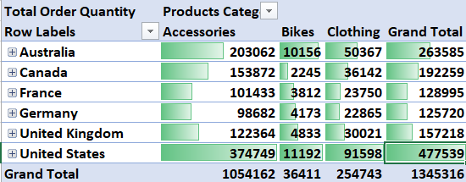
Total Order Quantities Per Country

